Slide 1
Multi-dimensional Robust Synthetic Control
(mRSC)
Dennis Shen
Massachusetts Institute of Technology
Muhammad J Amjad
Devavrat Shah
Massachusetts Institute of Technology
Vishal Misra
Columbia University

Slide 2
A Few Simple Questions
Question 1:
Is Drug A more effective than Drug B?
Question 2:
Which “ad creative” attracts more clicks?
Question 3:
Which recommendation engine drives up sales more?

Slide 3



A Simple (but Profound) Answer
Randomized Control [Pierce-Jastrow, Neyman, Fisher] [Hill]
Given access to large pool of patients / customers / …
each receives one possible “treatment” at random
Measure performances using treatment groups
Need large number for statistical significance!

Slide 4
A Few More “Simple” Questions
Question 1:
Is gun control effective in reducing crime rate in Massachusetts?
Question 2:
Does adding neon lights to a NYC store attract more customers?
Question 3:
What would be the outcome of a cricket game if it did not rain?

Slide 5



Not so Straightforward…
No, Randomized Control not feasible
Randomized Control Trial?
Cannot have multiple copies of
Massachusetts with and without gun control
Same NYC store with and without neon lights
Same cricket game with and without rain
Can’t compare over time because conditions change

Slide 6




Another Simple (but Profound) Answer
Synthetic Control [Abadie et al 2003]
= convex combination of “donors” $≈$ treatment unit
for metric of interest during “pre-intervention”
=
0.4
+ 0.5
+ 0.1
Key assumption: intervention applied to treatment unit, NOT donor units
Analyze: compare observed with synthetic

Slide 7
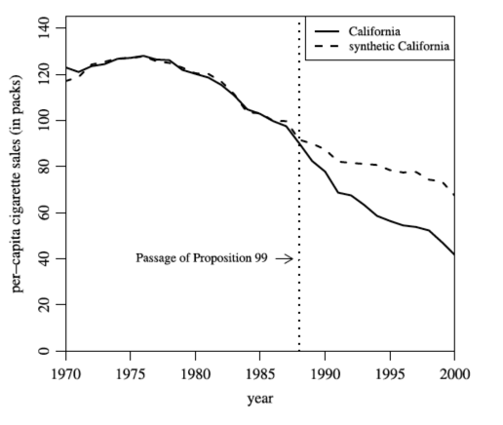
Example: CA Prop 99 [Abadie et al 2010]
Did Prop 99 impact cigarette sales?

Slide 8
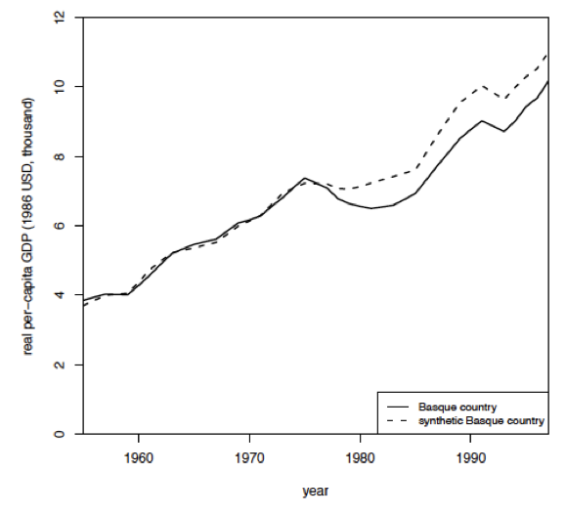
Example: Basque Country [Abadie et al 2010]
Did Terrorism affect economy in Basque Country?

Slide 9
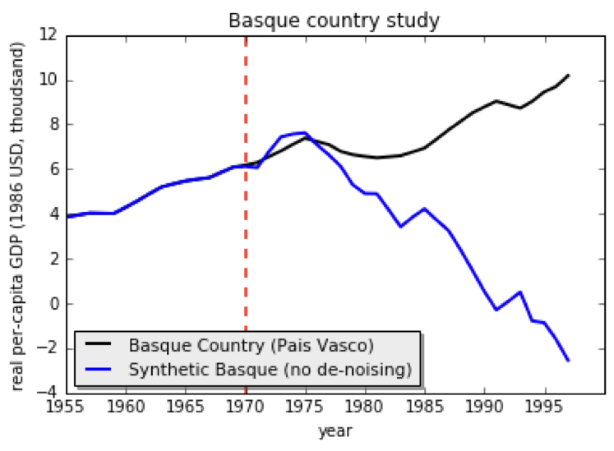
It’s Fragile Though…
SC: convex combination
convex combination
linear combination
Overfitting

Slide 10
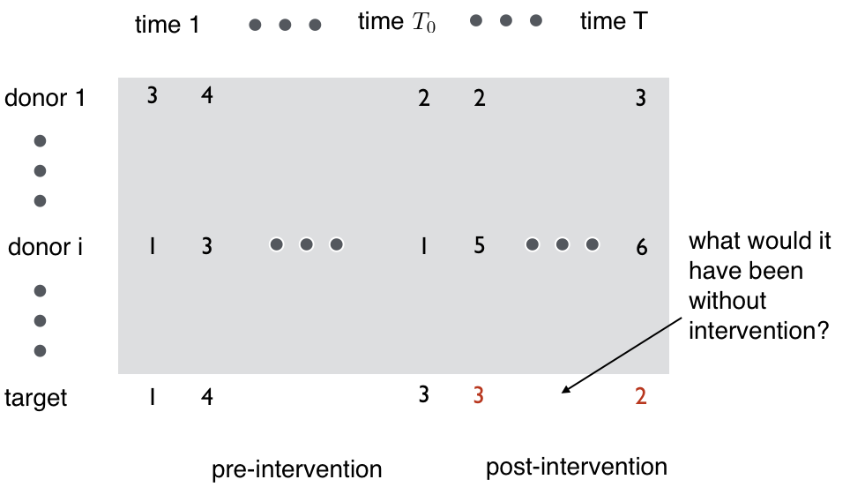

How to Overcome Overfitting
?
?
?
?
?
?
?
?
Matrix Estimation!

Slide 11
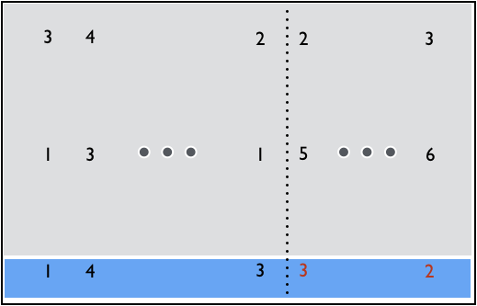
Robust Synthetic Control (RSC) [Amjad-Shah-Shen 2017]
Step 1: De-noising
Matrix estimation on grey
2
?
4
3
Step 2: Regression
Target: blue
Features: de-noised grey
Training data: pre-intervention
2
6
2
?
?
1
4
3
3
?
?
2
Step 3: Prediction
Estimate red using de-noised
post-intervention grey
Pre-intervention
Post-intervention

Slide 12
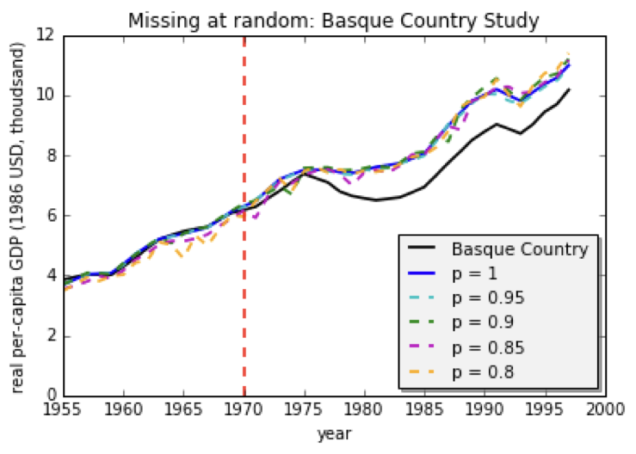
Impact of De-noising
No de-noising
With de-noising

Slide 13
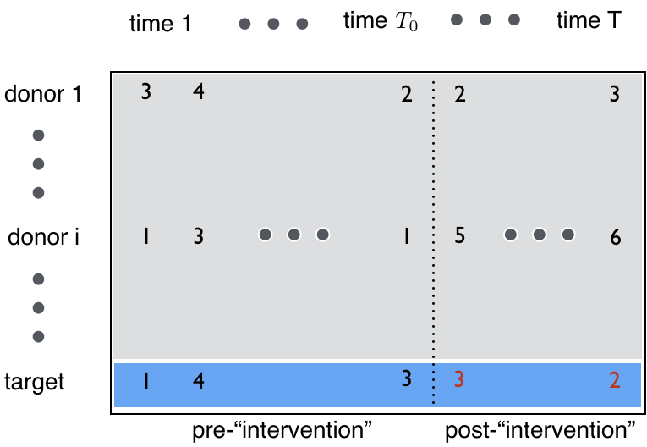
RSC for “Forecasting”
If no intervention, then predicting factual!

Slide 14
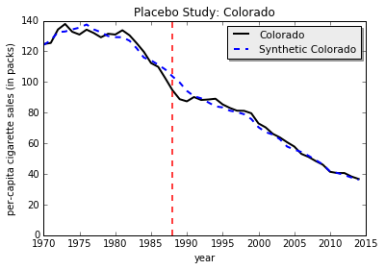
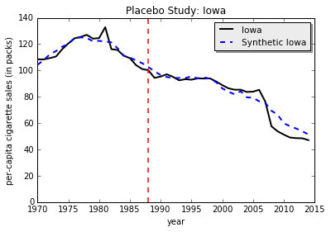
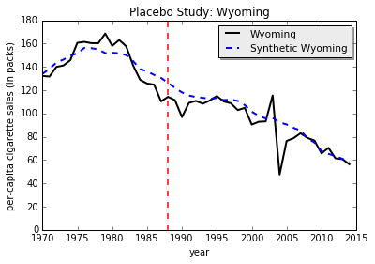
RSC for “Forecasting” / Placebo Study
No intervention → counterfactual $≈$ observed
Estimating mean effect → Smooth counterfactual

Slide 15
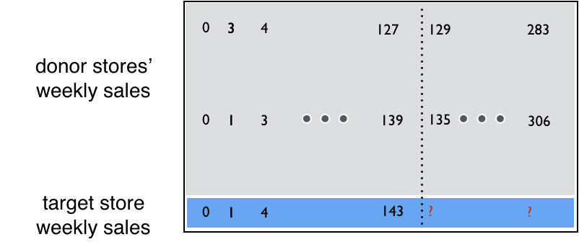
Example: Walmart
Predicting weekly sales at Walmart [Kaggle]

Slide 16
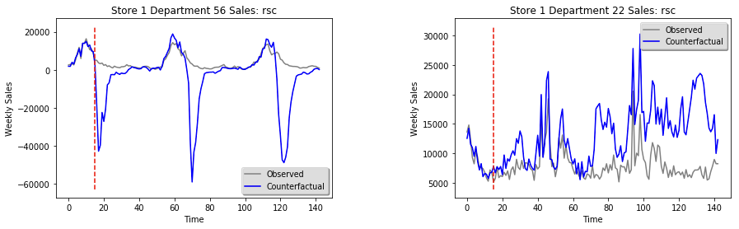
Example: Walmart
Recall: No intervention → counterfactual $≈$ observed
Negative values…
If pre-intervention is limited, then performance suffers…

Slide 17
Challenges of Limited Data
Unable to extrapolate well
Algorithmic remedy:
  Regularization – can only help so much…
Data remedy:
  Use auxiliary information
  e.g., median household income for crime-rate control
  e.g., sales of other products

Slide 18
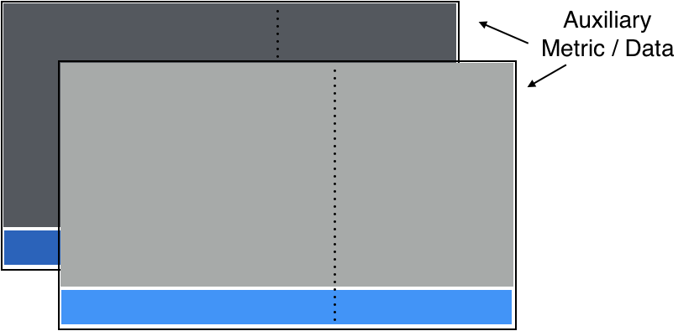
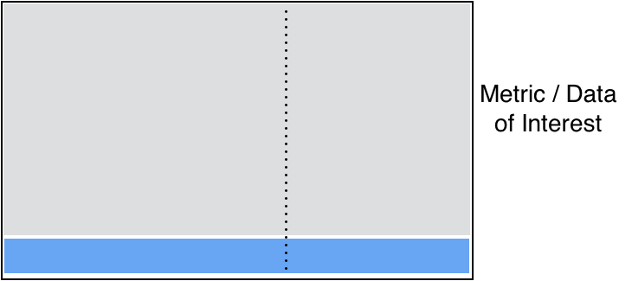
Multi-dimensional Robust Synthetic Control [Amjad-Misra-Shah-Shen 19]
Fix: use auxiliary metrics to identify donors for primary metric

Slide 19
Multi-dimensional Robust Synthetic Control [Amjad-Misra-Shah-Shen 19]
Step 0: Concatenate along donor dimension
Steps 1-2 (de-noise + regression): same as RSC
Step 3 (prediction): use donor data for primary metric

Slide 20
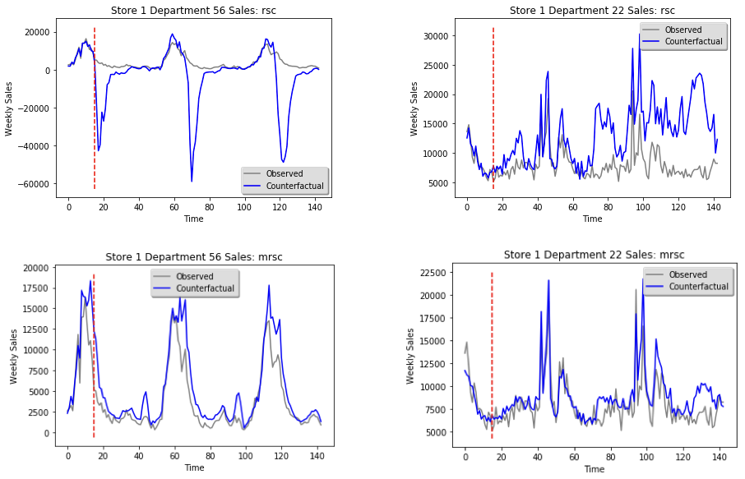
Example: Walmart
RSC
mRSC
Use sales information from other products

Slide 21



mRSC: Diagnostic Test
When can we use auxiliary metrics?
If (rank of
$$≠$$
rank of
):
Don’t use!
Else:
Use!

Slide 22



Example: Cricket (the sport…)
Team A
Team B
Ball | = | Pitch
Over | = | 6 Balls
Wicket | = | Out
Inning | = | 300 balls or 10 wickets
Forecasting wins: runs scored = primary metric

Slide 23
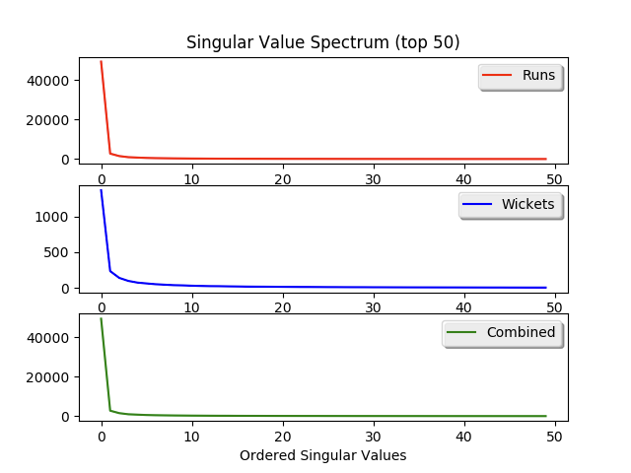
Cricket: Diagnostic Test
Can we use “wickets lost” metric?
Yes
rank preserved!

Slide 24
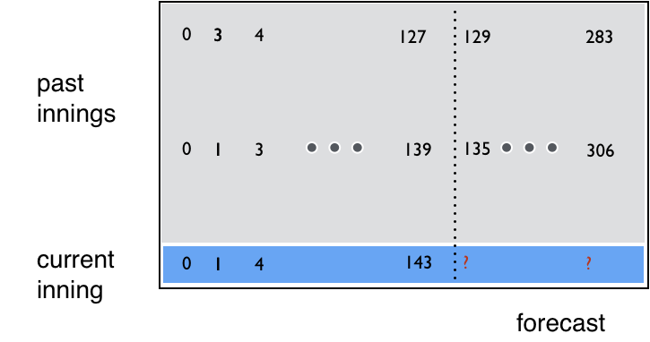
Cricket: Problem Formulation
balls

Slide 25


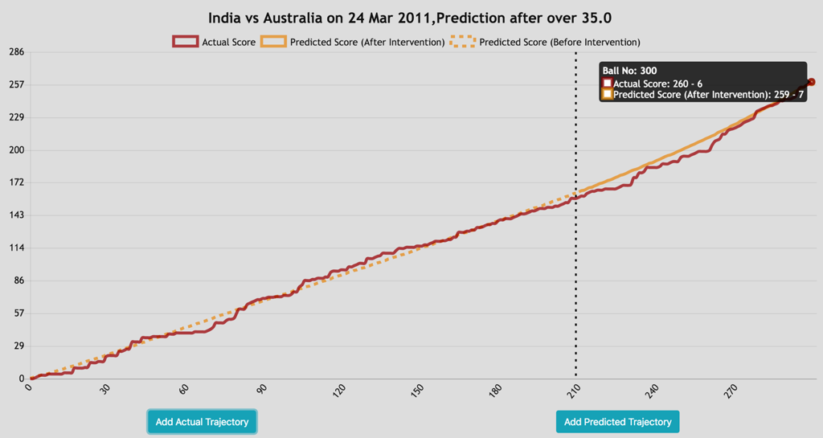
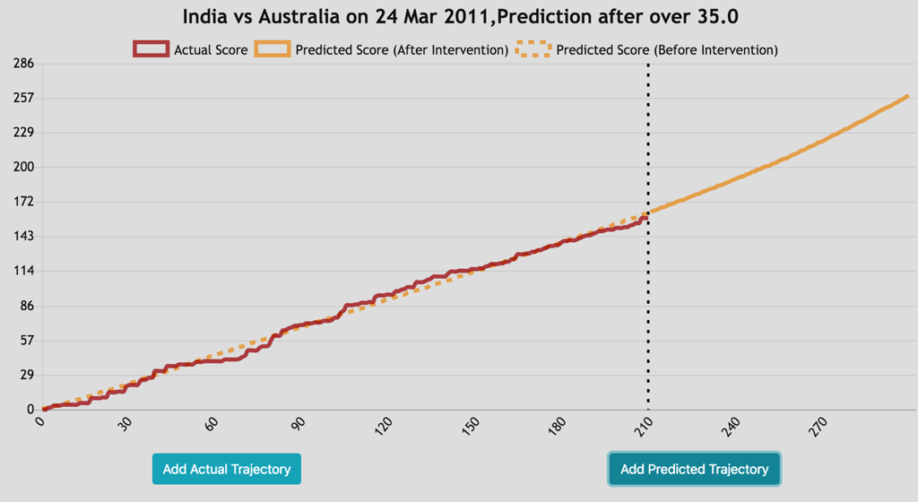

CricketML

Slide 26
Importance of Multi-metrics
State: (runs scored, wickets lost)
Sri Lanka vs. Australia, 2013
State: (192, 8) at 30th over
RSC: (254, )
mRSC: (225, 10)
Actual: (233, 10)
England vs. New Zealand, 2015
State: (291, 7) at 43rd over
RSC: (359, )
mRSC: (315, 10)
Actual: (302, 10)
Wickets lost is important!

Slide 27

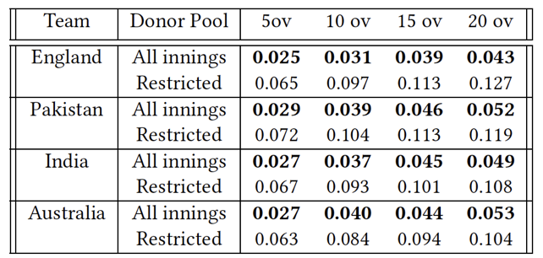
A Remark
Stein’s Paradox [+ Effron and Morris 1970s]:
Using performance of other players can improve predictions!
Cricket:
Using performance of other teams can improve predictions!
MAPE values

Slide 28

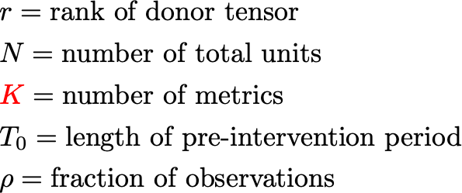
Results
Theorem (informal):
If additional metrics are valid, then
Takeaway: training data K times larger!

Slide 29
Summary of mRSC
Solves counterfactual inference problems where RCT fails
Improves estimation when pre-intervention data is limited
Predicts evolution of sequentially repeated and multi-metric settings
e.g., cricket
Thank you!

