Slide 1
Price Differentiation in the Kelly Mechanism
Richard Ma
Advanced Digital Sciences Center, Illinois at Singapore
School of Computing, National University of Singapore
Joint work with
Dah Ming Chiu, John Lui (Chinese University of Hong Kong)
Vishal Misra, Dan Rubenstein (Columbia University)
W-PIN 2012

Slide 2
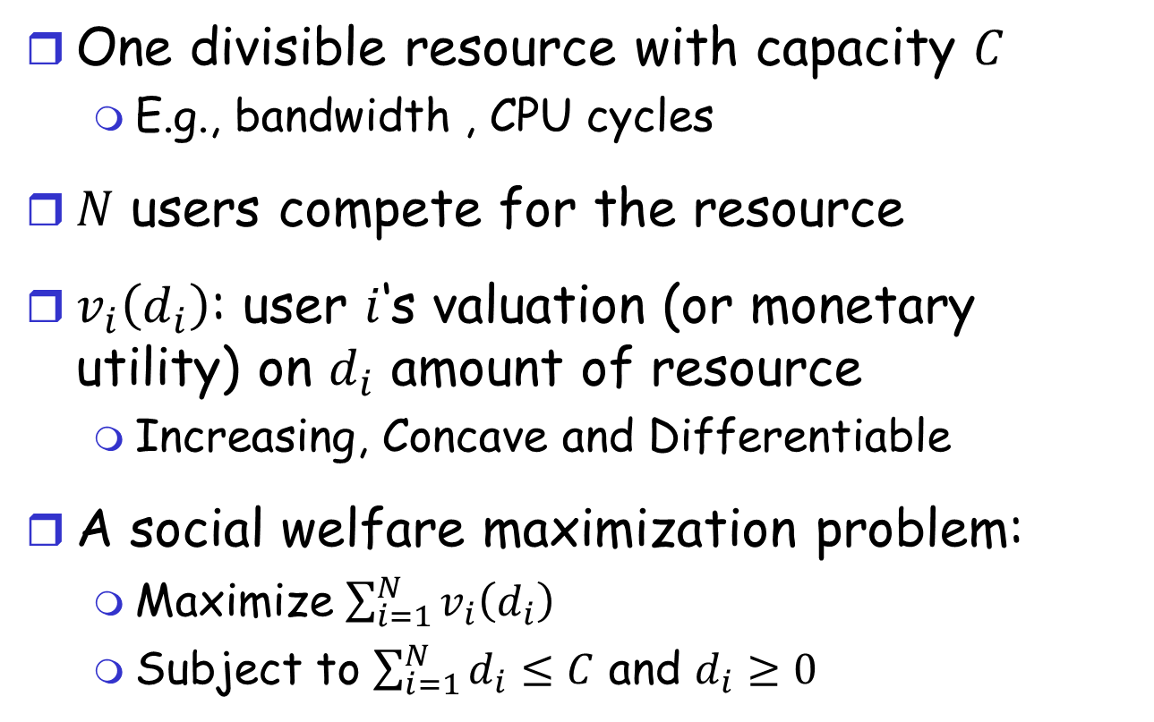
A Resource Allocation Problem
One divisible resource with capacity $C$
E.g., bandwidth , CPU cycles
$N$ users compete for the resource
$v_{i}\left(d_{i}\right)$: user $i$‘s valuation (or monetary utility) on $d_{i}$ amount of resource
Increasing, Concave and Differentiable
A social welfare maximization problem:
Maximize $\sum_{i=1}^{N}{v_{i}\left(d_{i}\right)}$
Subject to $\sum_{i=1}^{N}{d_{i}}≤C$ and $d_{i}≥0$
Notes:
The challenge is that $v_{i}\left(⋅\right)$ is unknown to the central planner.

Slide 3
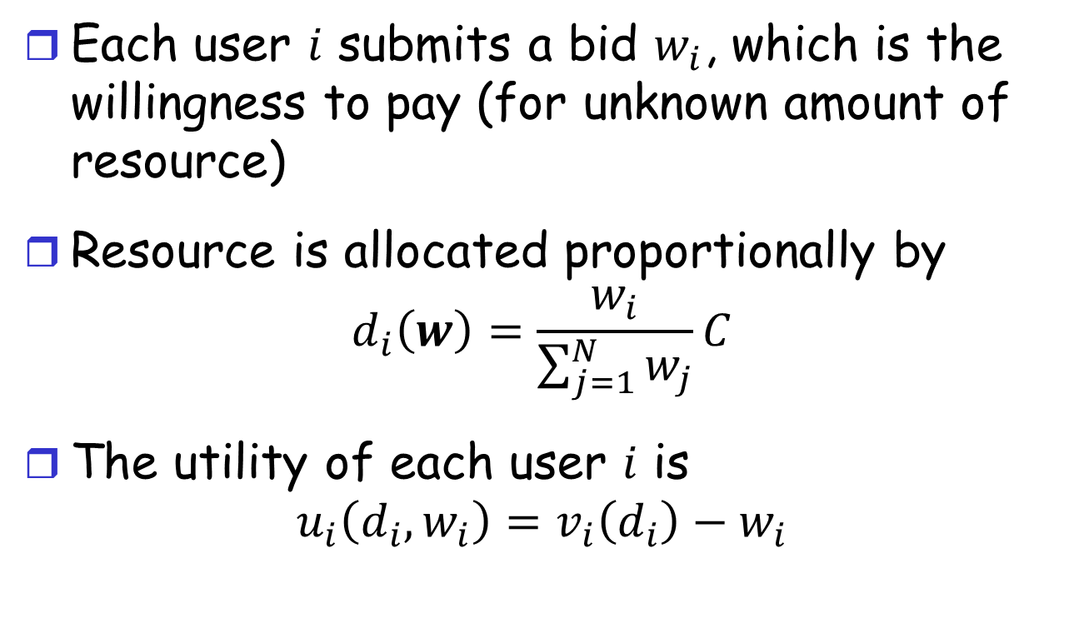
The Kelly Mechanism
Each user $i$ submits a bid $w_{i}$, which is the willingness to pay (for unknown amount of resource)
Resource is allocated proportionally by
$$d_{i}\left(w\right)=\frac{w_{i}}{\sum_{j=1}^{N}{w_{j}}}C$$
The utility of each user $i$ is
$$u_{i}\left(d_{i},w_{i}\right)=v_{i}\left(d_{i}\right)−w_{i}$$

Slide 4
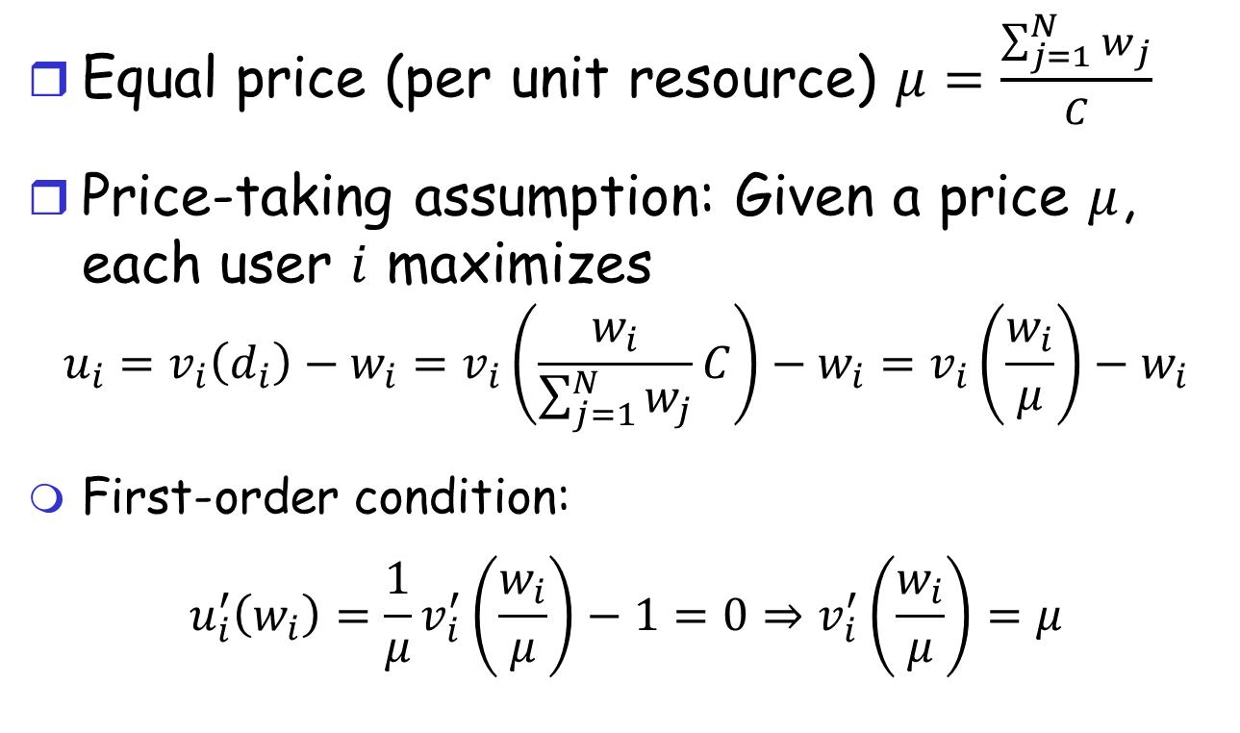
Properties of Kelly Mechanism
Equal price (per unit resource) $μ=\frac{\sum_{j=1}^{N}{w_{j}}}{C}$
Price-taking assumption: Given a price $μ$, each user $i$ maximizes
$$u_{i}=v_{i}\left(d_{i}\right)−w_{i}=v_{i}\left(\frac{w_{i}}{\sum_{j=1}^{N}{w_{j}}}C\right)−w_{i}=v_{i}\left(\frac{w_{i}}{μ}\right)−w_{i}$$
First-order condition:
$$u_{i}^{′}\left(w_{i}\right)=\frac{1}{μ}v_{i}^{′}\left(\frac{w_{i}}{μ}\right)−1=0⇒v_{i}^{′}\left(\frac{w_{i}}{μ}\right)=μ$$
Notes:
$$u_{i}^{′}\left(w_{i}\right)=\frac{1}{μ}v_{i}^{′}\left(\frac{w_{i}}{μ}\right)−1=0⇒v_{i}^{′}\left(\frac{w_{i}}{μ}\right)=μ$$

Slide 5
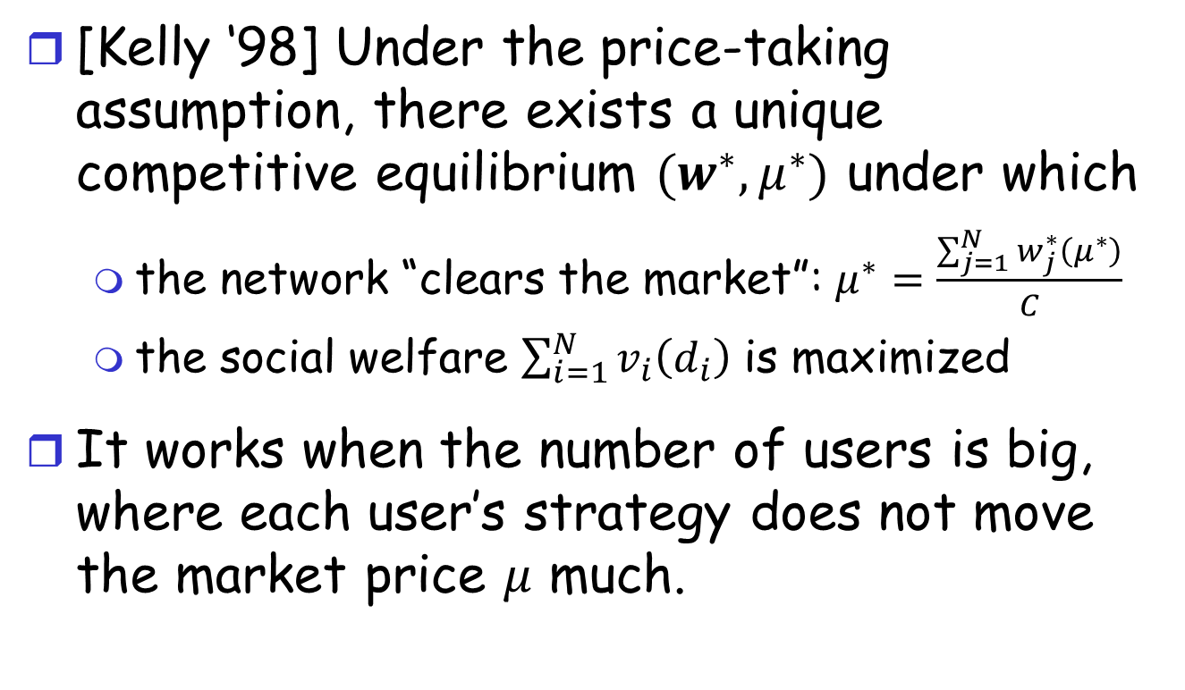
Properties of Kelly Mechanism
[Kelly ‘98] Under the price-taking assumption, there exists a unique competitive equilibrium $(w^{∗},μ^{∗})$ under which
the network “clears the market”: $μ^{∗}=\frac{\sum_{j=1}^{N}{w_{j}^{∗}\left(μ^{∗}\right)}}{C}$
the social welfare $\sum_{i=1}^{N}{v_{i}\left(d_{i}\right)}$ is maximized
It works when the number of users is big, where each user’s strategy does not move the market price $μ$ much.
Notes:
$$u_{i}^{′}\left(w_{i}\right)=\frac{1}{μ}v_{i}^{′}\left(\frac{w_{i}}{μ}\right)−1=0⇒v_{i}^{′}\left(\frac{w_{i}}{μ}\right)=μ$$

Slide 6
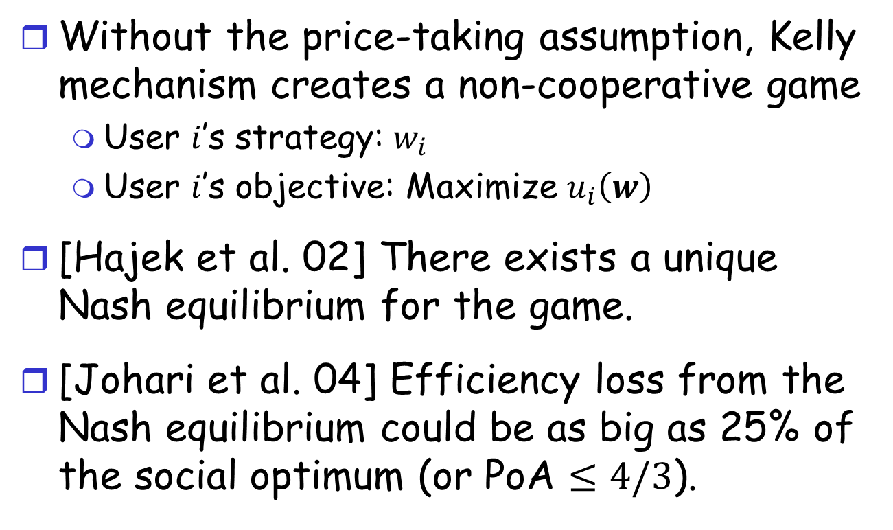
Non-cooperative Game
Without the price-taking assumption, Kelly mechanism creates a non-cooperative game
User $i$’s strategy: $w_{i}$
User $i$’s objective: Maximize $u_{i}\left(w\right)$
[Hajek et al. 02] There exists a unique Nash equilibrium for the game.
[Johari et al. 04] Efficiency loss from the Nash equilibrium could be as big as 25% of the social optimum (or PoA $≤4/3$).
Notes:
In other words, the price of anarchy is 4/3.

Slide 7

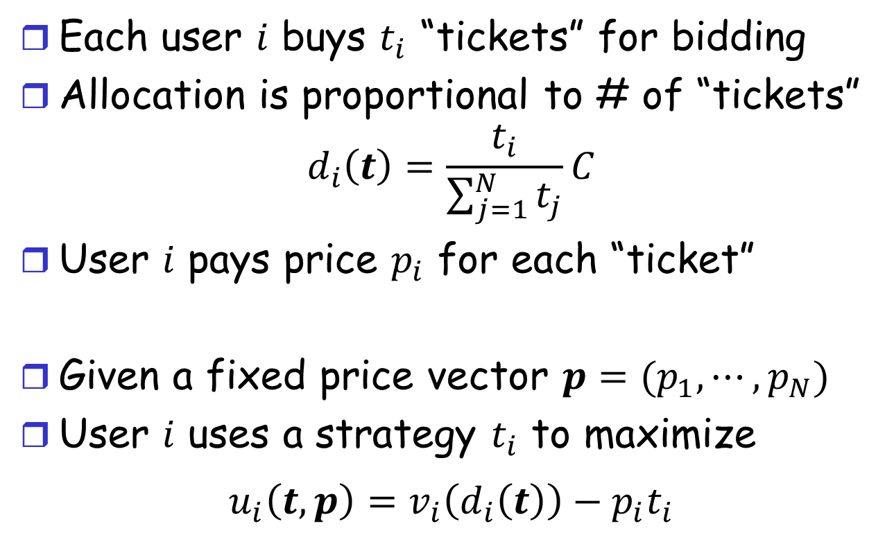
Price Differentiation $M^{p}$
Each user $i$ buys $t_{i}$ “tickets” for bidding
Allocation is proportional to # of “tickets”
$$d_{i}\left(t\right)=\frac{t_{i}}{\sum_{j=1}^{N}{t_{j}}}C$$
User $i$ pays price $p_{i}$ for each “ticket”
Given a fixed price vector $p=(p_{1},⋯,p_{N})$
User $i$ uses a strategy $t_{i}$ to maximize
$$u_{i}\left(t,p\right)=v_{i}\left(d_{i}\left(t\right)\right)−p_{i}t_{i}$$
Notes:
This can be seen as a generalization of the Kelly mechanism

Slide 8
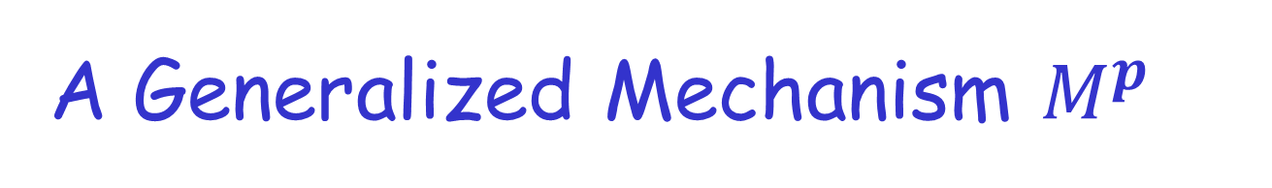
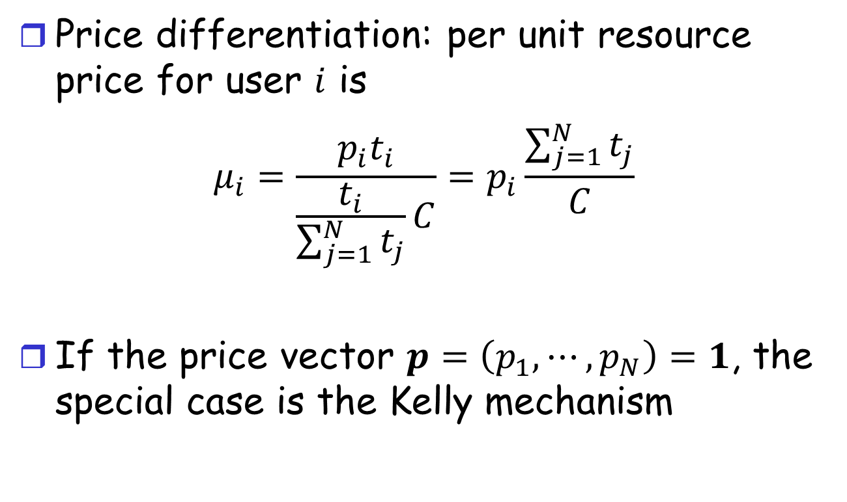
A Generalized Mechanism $M^{p}$
Price differentiation: per unit resource price for user $i$ is
$$μ_{i}=\frac{p_{i}t_{i}}{\frac{t_{i}}{\sum_{j=1}^{N}{t_{j}}}C}=p_{i}\frac{\sum_{j=1}^{N}{t_{j}}}{C}$$
If the price vector $p=\left(p_{1},⋯,p_{N}\right)=1$, the special case is the Kelly mechanism
Notes:
This can be seen as a generalization of the Kelly mechanism

Slide 9
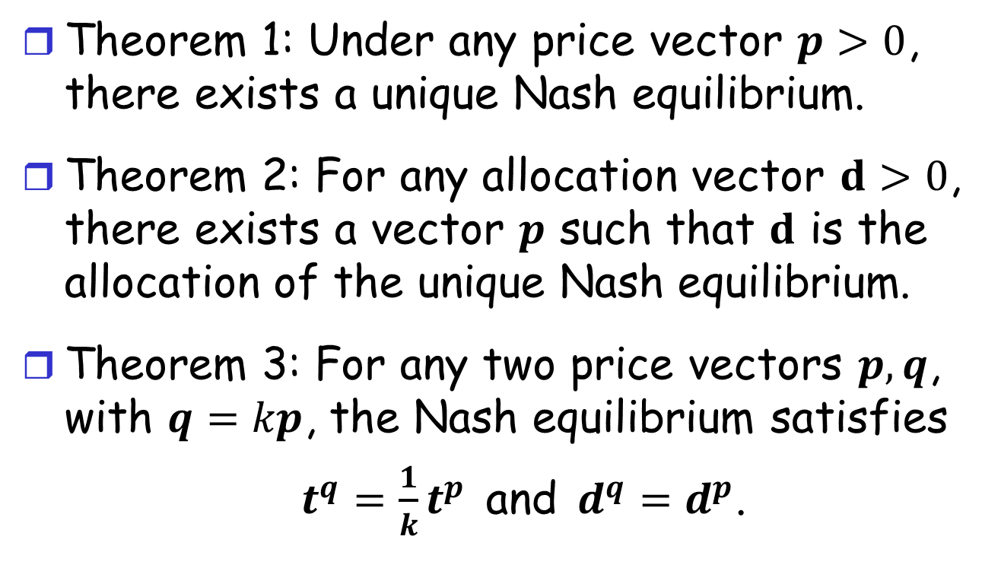
Properties
Theorem 1: Under any price vector $p>0$, there exists a unique Nash equilibrium.
Theorem 2: For any allocation vector $d>0$, there exists a vector $p$ such that $d$ is the allocation of the unique Nash equilibrium.
Theorem 3: For any two price vectors $p, q$, with $q=kp$, the Nash equilibrium satisfies
$t^{q}={\frac{1}{k}t}^{p}$ and $d^{q}=d^{p}$.

Slide 10
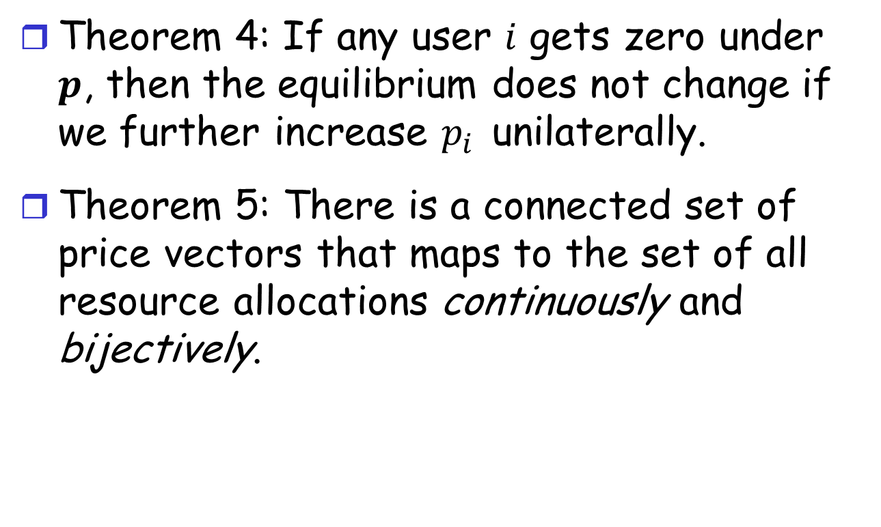
Properties
Theorem 4: If any user $i$ gets zero under $p$, then the equilibrium does not change if we further increase $p_{i}$ unilaterally.
Theorem 5: There is a connected set of price vectors that maps to the set of all resource allocations continuously and bijectively.
Notes:
Thm 4 implies that the best bid for user $i$ is $t_{i}=0$.
If under some price, it is not worth getting any resource, it won’t worth when the price is even higher.

Slide 11
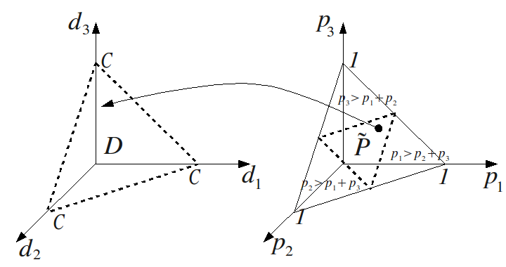


Mapping from $p$ to $d$
$$v_{1}\left(d\right)=v_{2}\left(d\right)=v_{3}\left(d\right)=kd$$
$$d_{i}\left(p\right)=\left(1−2p_{i}\right)C$$
Notes:
By Thm3, we can normalize $\sum_{i}{p_{i}}=1$
How to find the price vector to maximize social welfare?

Slide 12
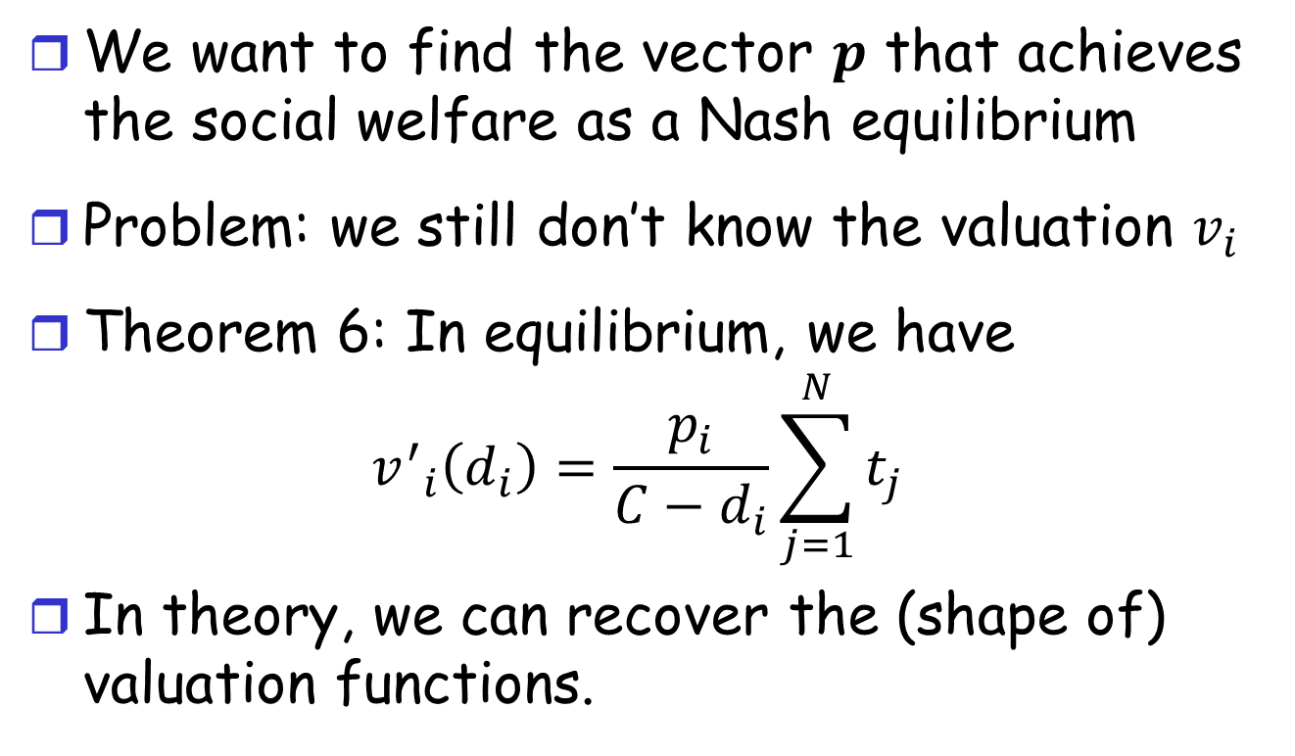
Valuation Revelation
We want to find the vector $p$ that achieves the social welfare as a Nash equilibrium
Problem: we still don’t know the valuation $v_{i}$
Theorem 6: In equilibrium, we have
$${v^{′}}_{i}\left(d_{i}\right)=\frac{p_{i}}{C−d_{i}}\sum_{j=1}^{N}{t_{j}}$$
In theory, we can recover the (shape of) valuation functions.

Slide 13
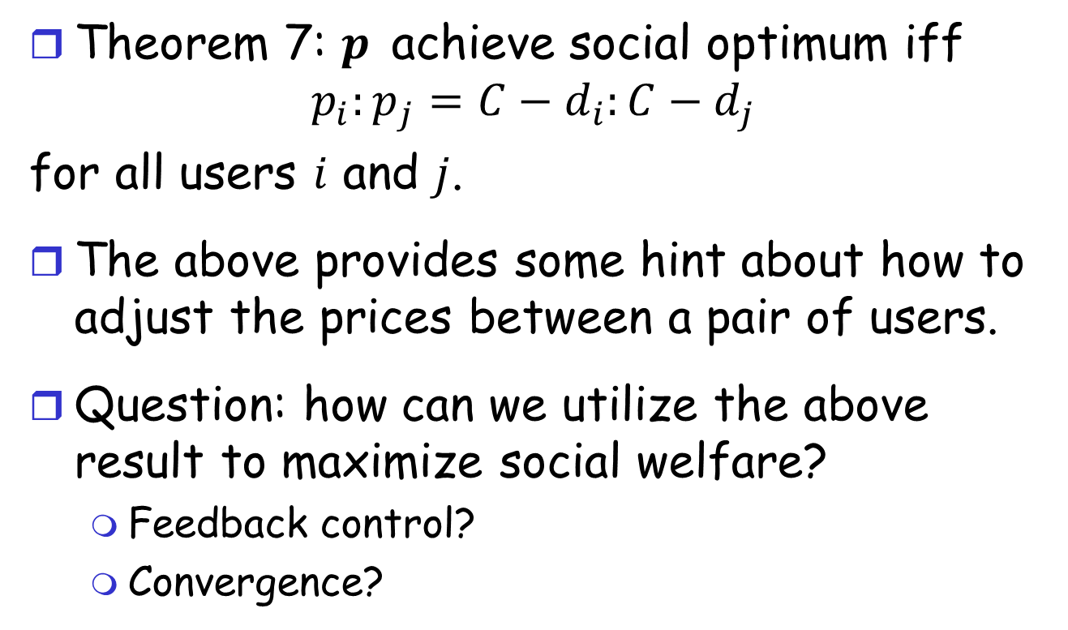
Unsolved Problem (Future work)
Theorem 7: $p$ achieve social optimum iff
$$p_{i}:p_{j}=C−d_{i}:C−d_{j}$$
for all users $i$ and $j$.
The above provides some hint about how to adjust the prices between a pair of users.
Question: how can we utilize the above result to maximize social welfare?
Feedback control?
Convergence?

